Slide 1
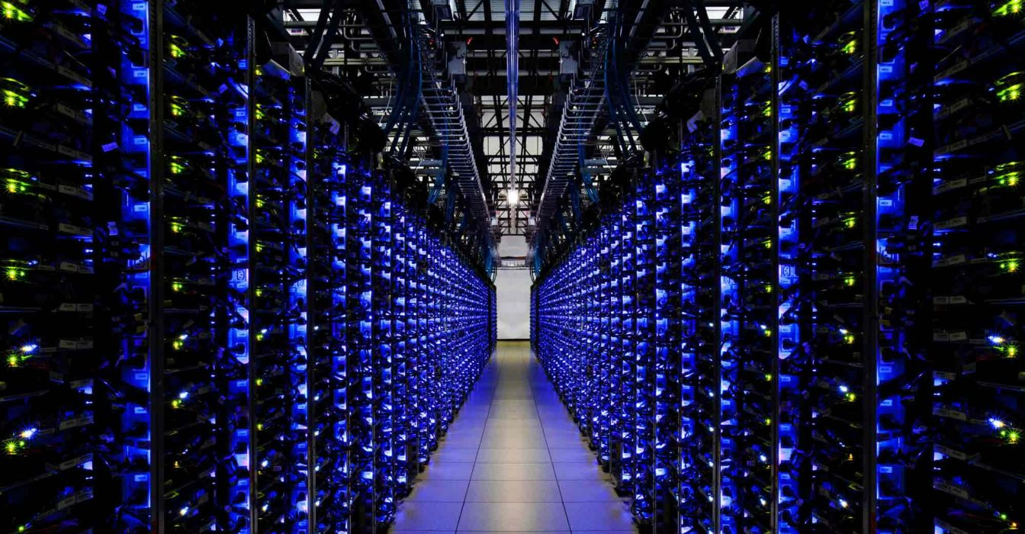
Virtualization
Textbook:
Mastering Cloud Computing :- Rajkumar Buyya

Slide 2
Contents:
Introduction
Characteristics of Virtualized Environment
Taxonomy of Virtualization Techniques
Virtualization and Cloud Computing
Pros and Cons of Virtualization
Technology Examples

Slide 3
Introduction
Fundamental Concept of CC- Infrastructure –as- a service.
Provides Secure, Customizable & Isolation environment
Core: Combination of both hardware & software to emulate environment separate from the one that host.
Not only virtual environment but also storage, Memory and Networking services.

Slide 4
Different Phenomena that leads to Virtualization
Increased Performance & Computing Capacity : Individual powerful system easy to Virtualize
Underutilized hardware & software resources : Limited usage of resources, after office hours.
Lack of Space : Birth of Data Centres, Google & Microsoft (football)
Server Consolidation : Aggregation of multiple services and apps deployed in multiple servers on a single physical server.
Greening Initiatives : Carbon Footprint, power utilization- power up& cool down
Rise of Administrative Cost: H/w Monitoring, defective replacement, Server setup and update, backup.

Slide 5
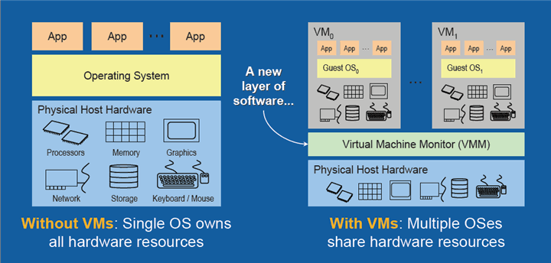
Characteristics of Virtualized Environment
Three Major components:
Guest – Interacts with virtualization layer
Host – Original Environment
Virtualization layer – responsible for recreating the same or a different environment where the guest will operate.

Slide 6








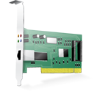




Virtualization Reference Model
Guest
Virtual Image
Applications
Applications
Virtualization Layer
Virtual Hardware
Virtual Storage
Virtual Networking
Software Emulation
Host
Physical Hardware
Physical Storage
Physical Networking

Slide 7
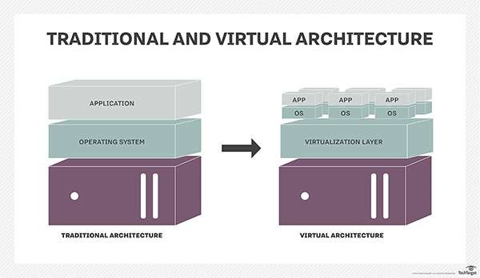

Slide 8
Most Popular is Hardware Virtualization
Guest- Represented by a system image compromising an OS and installed application. Installed on the top of virtual hardware- controlled and managed by virtualization layer- also called VMM ( Virtual Machine Manager).
Host- physical hardware.
Virtual Storage- Guest may be client app that interacts with the
Virtual storage Management s/w deployed on real storage system.
Virtual Networking: the guest interacts with a virtual network, such as VPN.

Slide 9
Advantages
Increased Security
Managed Execution
Sharing
Aggregation
Emulation
Isolation
Portability
Performance Tuning
Virtual Machine Migration

Slide 10


Functions Enabled by Managed Execution
Virtual Resources
Sharing
Aggregation
Emulation
Isolation
Virtualization
Physical Resources

Slide 11


Taxonomy of Virtualization Techniques
How it is done?
Technique
Virtualization Model
Emulation
Application
Execution Environment
Process Level
High-Level VM
Programming Language
Storage
Multiprogramming
Operating System
Virtualization
Network
Hardware-assisted
Virtualization
Full Virtualization
System Level
Hardware
….
Paravirtualization
Partial Virtualization

Slide 12
Classification
Virtualization used to emulate:
Execution Environment- oldest, popular, developed area
Storage
Network
Execution environment classified in to
Process level- Implemented on the top of existing OS.
System level- Implemented directly on hardware, minimum require/ may not require existing OS.
Above two categories gives different types to guest: Bare h/w, OS resources, low-level programming language and application libraries.

Slide 13
Execution Virtualization
It includes all those techniques whose aim is to emulate an execution environment that is separate from the one hosting the virtualization layer.
It can be implemented directly on the top of hardware, by the OS, an application, or libraries or statistically linked against an application image.

Slide 14
Machine Reference Model
Virtualizing an execution environment at different levels of the computing stack requires a reference model that defines the interfaces between the levels of abstractions, which hide implementation details.
From this perspective, virtualization techniques actually replace one of the layers and intercept the calls that are directed toward it.
Modern computing systems can be expressed in terms of the reference model

Slide 15
A Machine Reference Model
Applications
Applications
API calls
API
Libraries
Libraries
ABI
System calls
User
ISA
User
ISA
Operative System
Operative System
ISA
ISA
Hardware
Hardware

Slide 16
Bottom layer- Hardware- Instruction Set Architecture (ISA), which defines the instruction set for the processor, registers, memory, and interrupt management. ISA is the interface between hardware and software.
The application binary interface (ABI) separates the operating system layer from the applications and libraries, which are managed by the OS. ABI covers details such as low-level data types, alignment, and call conventions and defines a format for executable programs. System calls are defined at this level.

Slide 17
The highest level of abstraction is represented by the application programming interface (API), which interfaces applications to libraries and/or the underlying operating system.
For any operation to be performed in the application level API, ABI and ISA are responsible for making it happen.
The high-level abstraction is converted into machine-level instructions to perform the actual operations supported by the processor

Slide 18
This layered approach simplifies the development and implementation of computing systems and simplifies the implementation of multitasking and the coexistence of multiple executing environment.
It also provides ways to implement a minimal security model for managing and accessing shared resources.
The hardware has been divided into different security classes that define who can operate with them. The first distinction can be made between privileged and nonprivileged instructions

Slide 19
Based on security we have 2 classes
Nonprivileged instructions - they do not access shared resources.
( floating, fixed-point, and arithmetic instruction)
Privileged instructions - that are executed under specific restrictions and are mostly used for sensitive operations, which
Expose (behaviour-sensitive) : Instructions operate on I/O
Modify (control-sensitive) – Alter the state of CPU registers.

Slide 20
A possible implementation features a hierarchy of privileges in the form of ring-based security
Least privileged mode
(user mode)
Ring 3
Privileged modes
Ring 2
Ring 1
Ring 0
Most privileged mode
(supervisor mode)

Slide 21
Recent systems support only two levels, with Ring 0 for supervisor mode and Ring 3 for user mode.
Supervisor Mode ( Master Node/ Kernel Node): All instructions without any restriction.
User Mode: Restrictions to control Machine-level resources.
Hypervisor- Runs above the supervisor node

Slide 22
Hardware-level Virtualization /system virtualization
The guest is represented by the operating system,
The host by the physical computer hardware,
The virtual machine by its emulation,
And the virtual machine manager is the hypervisor

Slide 23

Hardware Virtualization Reference Model
Guest
In memory
representation
Virtual Image
Storage
VMM
Host emulation
Virtual Machine
binary translation
instruction mapping
interpretation
……
Host

Slide 24
Hypervisor
Two types:
Type 1: native virtual machine, runs natively on hardware.
Type I hypervisors run directly on top of the hardware.
Type 2: a hosted virtual machine since it is hosted within an operating system.
Type II hypervisors require the support of an operating system to provide virtualization services

Slide 25
Difference in Picture
VM
VM
VM
VM
ISA
Virtual Machine Manager
VM
VM
VM
VM
ABI
ISA
Operative System
Virtual Machine Manager
ISA
ISA
Hardware
Hardware

Slide 26



Hypervisor Reference Architecture
Virtual Machine Instance
ISA
Instructions (ISA)
Virtual Machine Manager
Dispatcher
Interpreter
Routines
Interpreter
Routines
Allocator

Slide 27
Hypervisor
Three Modules:
Dispatcher : Constitutes the entry point of the monitor and reroutes the instructions issued by the virtual machine instance to one of the two other modules.
Allocator: Decides the system resources to be provided to the VM.
Interpreter : Consists of interpreter routines.

Slide 28
Three criteria properties have to be satisfied
Equivalence: A guest running under the control of a virtual machine manager should exhibit the same behaviour as when it is executed directly on the physical host.
Resource control: The virtual machine manager should be in complete control of virtualized resources.
Efficiency: A statistically dominant fraction of the machine instructions should be executed without intervention from the virtual machine manager.

Slide 29
Three Theorem- to satisfy in order to efficiently support virtualization
T-3.1: For any conventional third-generation computer, a VMM may be constructed if the set of sensitive instructions for that computer is a subset of the set of privileged instructions.
T-3.3: A hybrid VMM may be constructed for any conventional third-generation machine in which the set of user-sensitive instructions is a subset of the set of privileged instructions.
T-3.2: A conventional third-generation computer is recursively virtualizable if:
It is virtualizable and
A VMM without any timing dependencies can be constructed for it

Slide 30
Hardware Virtualization Techniques
Hardware-assisted virtualization
Full Virtualization
Paravirtualization
Partial Virtualization

Slide 31
Hardware virtualization techniques
This term refers to a scenario in which the hardware provides architectural support for building a virtual machine manager able to run a guest operating system in complete isolation.
At present, examples of hardware-assisted virtualization are the extensions to the x86-64 bit architecture introduced with Intel VT and AMD V
Examples: Kernel-based Virtual Machine (KVM), VirtualBox, Xen, VMware, Hyper-V, Sun xVM, Parallels, and others.

Slide 32
Full Virtualization
Ability to run OS directly on top of a virtual machine and without any modification
VMM require complete emulation of underneath h/w.
Advantages:
Complete Isolation
Enhanced Security
Ease of emulation of different architecture and coexistence

Slide 33
Paravirtualization
Not transparent virtualization
Thin VMM
Exposes s/w interface to the VM that is slightly modified from the host.
Guest OS need to be modified.
Simply transfer the execution of instructions which were hard to virtualized , directly to the host.

Slide 34
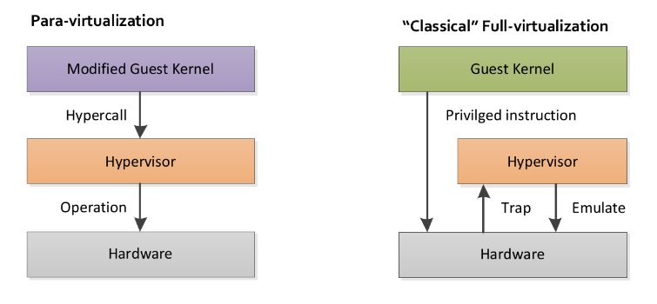
Difference between Para and Full

Slide 35
Partial Virtualization
Partial emulation of the underlying h/w.
Not allow complete isolation to guest OS
Address space virtualization is a common feature of contemporary OS.
Address space virtualization used in time-sharing system.

Slide 36
Operating System- Level virtualization
It offers the opportunity to create different and separated execution environments for applications that are managed concurrently.
No VMM or hypervisor
Virtualization is in single OS
OS kernel allows for multiple isolated user space instances.
Good for server consolidation
Ex: Chroot, Jails, OpenVZ etc.,

Slide 37
Programming Language-Level Virtualization
It is mostly used to achieve ease of deployment of application, managed execution and portability across different platforms and OS.
It consists of a virtual machine executing the byte code of a program, which is the result of the compilation process.
Produce a binary format representing the machine code for an abstract architecture.
Stack- based virtual machines
Ex: JVM, .NET provides Common Language Infrastructure (CLI).

Slide 38
Advantages
Provides uniform execution environment across different platforms.
This simplifies the development and deployment efforts
Allow more control over the execution of programs.
Security; by filtering the I/O operations
Easy support for sandboxing.

Slide 39
Application- level virtualization
Technique allowing applications to run in runtime environments that do not natively support all the features required by such applications.
“Single Executable and run anywhere”.
The software application is separated from the OS and runs in what is referred to as a “SANDBOX”.
Applications are not installed in the expected runtime environment,
Technique most concerned with
Partial file system
Libraries
OS component emulation

Slide 40
Two strategies to implement Application-level
Interpretation: Every source instruction is interpreted by an emulator for exe native ISA instructions,
Minimal start up cost but huge overhead.
Binary translation:
Every source instruction is converted to native instructions with equivalent functions.
Block of instructions: translated, cached and reused.
Large overhead coast, but over time it is subject to better performance,

Slide 41
Other types of Virtualization
Storage: allows decoupling the physical organization of the h/w from its logical representation. SAN
Network virtualization : combines h/w appliances and specific s/w for the creation and management of a virtual n/w.
It can aggregate different physical networks into a single logical network. VLAN
Desktop Virtualization
Application-server Virtualization

Slide 42
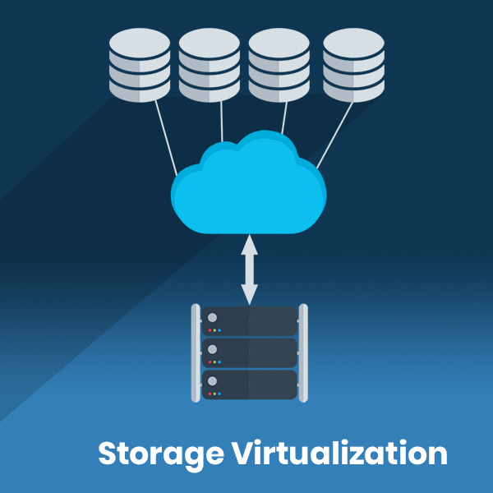
Storage Virtualization

Slide 43
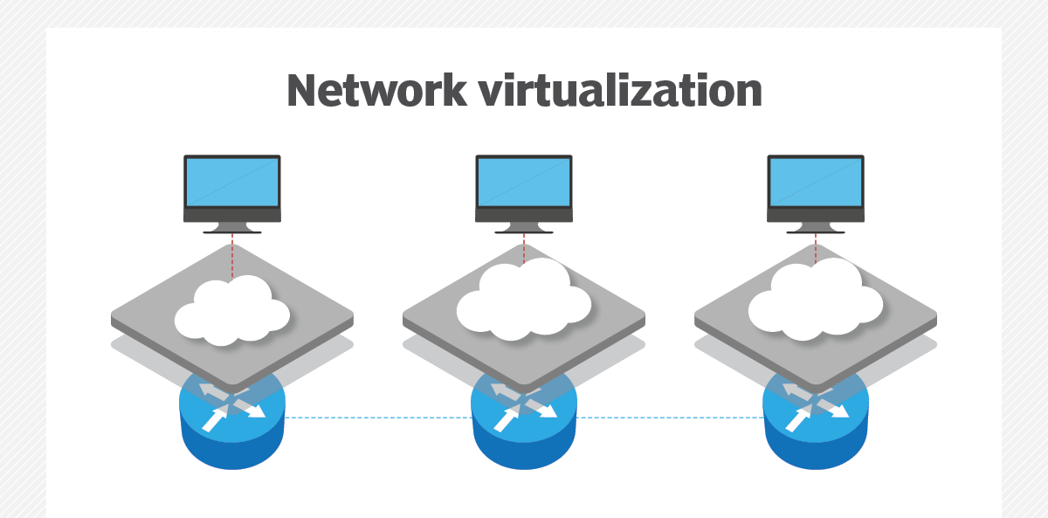

Slide 44
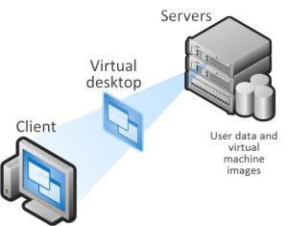
Desktop Virtualization

Slide 45
Disadvantages:
Upfront Costs
Software Licensing Considerations
Performance Degradation
Inefficiency and degraded user experience.
Security holes and new threats

